Slide 1
Assignment - 9
Snehal Deshmukh

Slide 2
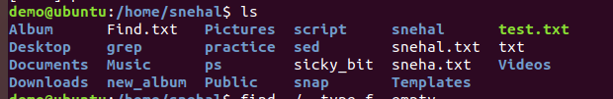
Find.txt is empty file.

Slide 3
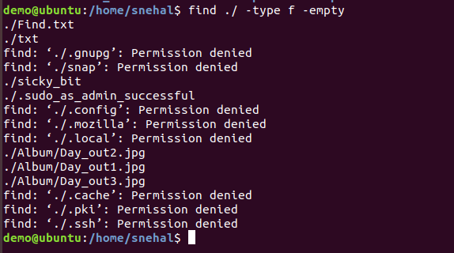
This will find all empty files in the specified directory and its subdirectories.

Slide 4
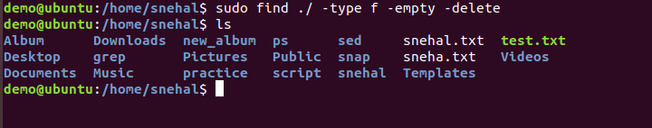
The -delete option is used to directly delete the files found by the find command

